Slide 1
COMPLETE

Slide 2


Slide 3

Congratulation
You have done
a great job!

Slide 4
Aims reached
Indicators in the project description
R1. One joint report of the desk-analysis and surveys containing results about RU
R2. One joint report of the desk-analysis and survey containing results about KZ
R3.Institutional analysis reports regarding all structures, departments and regulations for all PC HEI available
R3: Analysis findings could be used for the report and apt competence models created

Slide 5

Success Institutional Reports
Questionnaires developed
Online survey conducted
Competence model used
3 target groups reached
Important findings gained
Differences elaborated
SWOT – Analyses derived
existing parts of probable
Competence Centers identified
further needs / challenges elaborated
Interview guideline developed
Interviews conducted
Competence model used
Employers reached
Requirements specified

Slide 6
Success National Reports
National political agenda (concerninig employability) analysed
National framework examined
Conditions of the national labor market elaborated
Preconditions of the educational system and the Higher Education landscape carved out

Slide 7
Remarks to the format
Short scientific presentation of the university
Concentration on the relevant aspects of our project (topic)
No personal opinions
Scientific lay-out (just text and diagrams)
English words only (Titles)
Current sources
Readable texts (no „heavy pages“, structure, titles, subtitles, line spacings)
Page numbers

Slide 8
Tasks left
Employability
Definition
Glossary
Borderlines to Employment, Competitiveness, Ability to work,
As a set of competences vs. as a strategy
Self-employment, entrepreneurial skills
Competence Model
Elaboration of the used Competence model (source, scientific context, topicality, differenciation)
References between the results of the surveys and the competence model
Conclusions for the further development of the competence model

Slide 9
Tasks to be refined
Detailed representation of the research design in the reports
Overview / Analysis of general results
Discrimination of the results of the online research and the results of the in-depth interviews ( chance of picking up new perspectivs)
Comparison of the results (of different target groups)
Question: the own standpoint of Higher Education ⇨

Slide 10
Controversial Debate
To what extend should
curricula, teaching and learning
be geared to
employers‘ expectations
be designed to prepare for employment
emphasize on
academic quality
Knowledge for its own sake
Cultural enhancement
Civic responsibility
study programms aim to serve specialized knowledge?
‚generic skills‘ or key competences be promoted?
(Teichler 2011, 5)
Lippegaus

Slide 11
The Role of Higher Education
“Education, and particularly higher education,
cannot be reduced to skills.
The role of universities is crucial
for the future well-being of Europe.
Higher education, together with research,
contributes to growth, employment and innovation.
Education and higher education
shape critical thinking and social behaviour and contribute to cultural awareness and European citizenship.”
http://www.hrk.de/
German Rectors‘ Conference (HRK)
University of Vienna
Employability (in HEI) has to be
science-based, not based on economy.
http://lehrentwicklung.univie.ac.at/fileadmin/le/files/pdf/Survey_employability_16_05_2008.pdf
Lippegaus

Slide 12
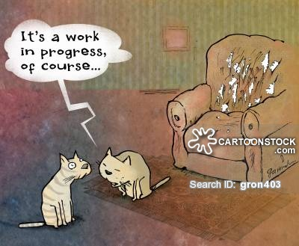
The End?

Slide 13
    Petra Lippegaus-Grünau
    +49 521 9 66 55 249
    www.fh-mittelstand.de
    lippegaus@fh-mittelstand.de

