Slide 1
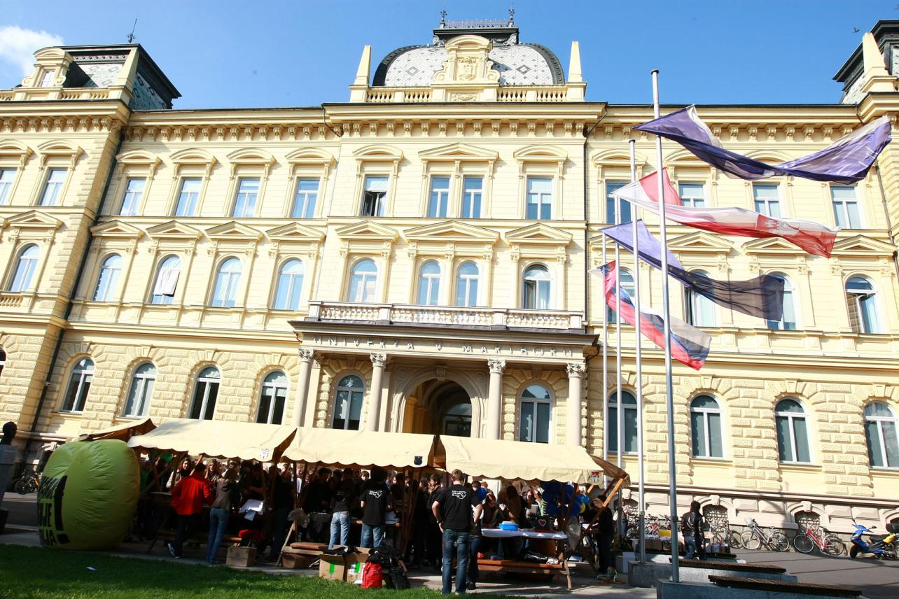
www.um.si [mind.youare]
Associate Professor Andrej Lisec, PhD

Slide 2
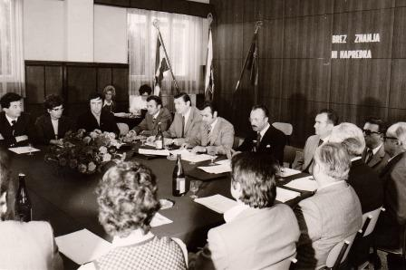
Overview
1859 beginnings of higher education in Mb
1959 - 1961 Association of Higher Education Institutions in Maribor
1975 University of Maribor established

Slide 3
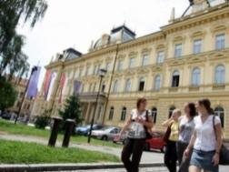
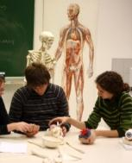
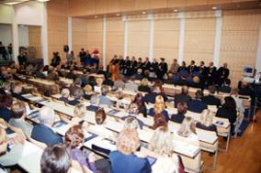
University of Maribor
17 faculties, 2 members (Student dormitories and University library)
19.369 students (BSc. 15.294, MSc. 3497, PhD 577)
1.739 staff (1.038 teaching, 701 administration and technical support)

Slide 4
Faculty of Economics and Busines
Faculty of Electrical Engineering and Computer Science
Faculty of Law
Faculty of Civil Engineering, Transportation Engineering and Architecture
Faculty of Agriculture and Life Sciences
Faculty of Chemistry and Chemical Engineering
Faculty of Health Sciences
Faculty of Organizational Sciences
Faculty of Medicine
Faculty of Mechanical Engineering
Faculty of Criminal Justice and Security
Faculty of Logistics
Faculty of Arts
Faculty of Natural Sciences and Mathematics
Faculty of Energy Technology
Faculty of Education
Faculty of Tourism

Slide 5
MISSION
The mission of the University of Maribor is based on the quest for knowledge, authenticity, creativity, freedom of spirit, cooperation and the exchange of information in science, arts and education. In its concern for humanity and sustainable development, the University of Maribor enriches our store of knowledge, strengthens humanist values, raises our level of awareness, a culture of dialogue, the quality of life and justice throughout the world.

Slide 6
VISION
The University of Maribor will be a globally recognized ecosystem of innovation in which the students and staff will enthusiastically engage in creative activity.

Slide 7
Faculty of Logistics
In 2005 opens its doors to the first students
481 students
Bologna study programmes 1st, 2nd and 3rd degree
E-learning (E-lessons, E-exercises, E-learning materials)

Slide 8
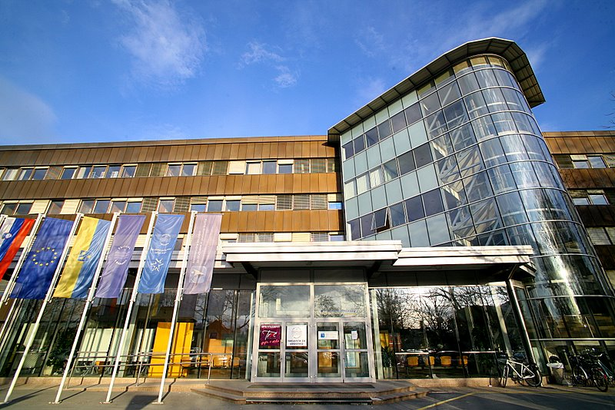

Slide 9
FACULTY OF LOGISTICS
leading academic and research institution in the field of logistics in Slovenia,
we strive for useful, practical and innovative study and to provide graduates with knowledge that offers good employment prospects,
we foster close and long-term partnerships with key business entities providing logistics services in Slovenia,
our scientific researches and their results provide support to the economy in meeting its challenges.

Slide 10
INTERNATIONAL COOPERATION
Accredited, evaluated study programmes
International accreditations: ACBSP, ECBE
Students Mobility Programmes,
Erasmus+, Ceepus,
SPH –Scientific Publishing Hub,
Joint degree programme Logistics in Economy with Subotica, Republic of Serbia.

Slide 11
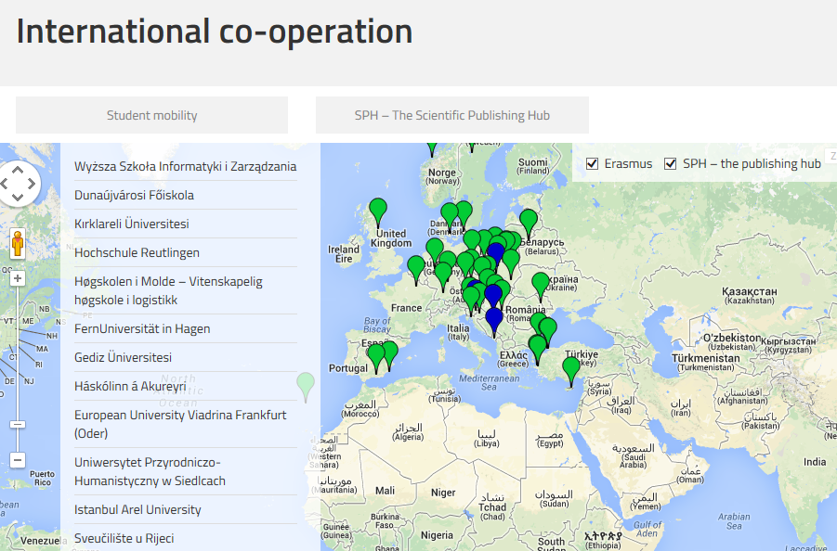

Slide 12
RESEARCH PORTFOLIO
The basic fields of scientific research at the Faculty of Logistics are:
Quantitative Modelling in Logistics,
Technical Logistics,
Supply Chain and Sustainable Development,
Management in Logistics,
and Military Logistics.
TOPICS
Green Logistics and Sustainable Transport
Logistics Network
City Logistics, Mobilistics and Tourism Logistics
Trustworthy Transport Chain
»On Port Choice«
Lean Intralogistics
Supply Chain Management
Competencies in Logistics
Risk Management and Management of Investments in Supply Chains
Crisis Communication: Lack of Awareness of Interdependence and Social Responsibility
Terminology in Logistics
Cargo securing in transport
Warehousing and order picking
Material handling system and intralogistics
Project management
Packaging

Slide 13
CONFERENCES
International Conference on Logistics & Sustainable Transport
International Students Symposium in Logistics and International Business
Agricultural Logistics
Summer School on Logistics

Slide 14
FOR MORE INFORMATION
VISIT OUR WEBPAGE
http://fl.um.si/en
Thank you for your attention.

